Slide 1

Chapter One (a)
CIS 201 - Fundamentals of Web Design
Software Engineering Department
College of Engineering and Architecture
Al Yamamah University
Fundamentals
Instructor: Layla Albabtain Spring 2019

Slide 2
What do you know?!
What do you know about web pages, web pages design and development?

Slide 3
Let’s Have fun
Lets create a web page!!

Slide 4
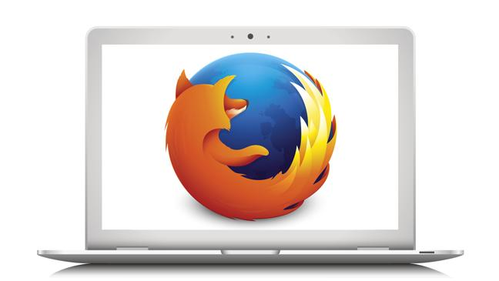
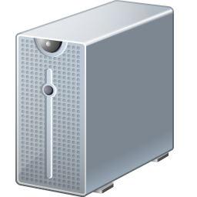
How?!
Internet

Slide 5
Opening a Webpage
Type URL
Create HTTP Request
Send HTTP Request
Via TCP/IP
Receive HTTP Request
Process HTTP Request
Receive Response
Send Response
Display Response

Slide 6
How?! What?!
We access web pages using Browsers installed on our devices.
E.g Firefox, Safari.
The web pages are shared by the Wold Wide Web.
The pages are stored on Servers.
The Browser send an HTTP request to Servers via the Internet.
HTTP: Heypertext Transfer protocol.
The server will send a response.

Slide 7
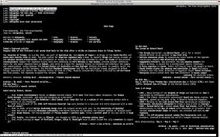
Web Browsers
Browsers are programs running on client machines.
They are called browsers because they allow the user to browse the resources available on servers.
The first browsers were text based
They were not capable of displaying graphic information, nor did they have a graphical user interface.
This limitation effectively constrained the growth of the Web.

Slide 8
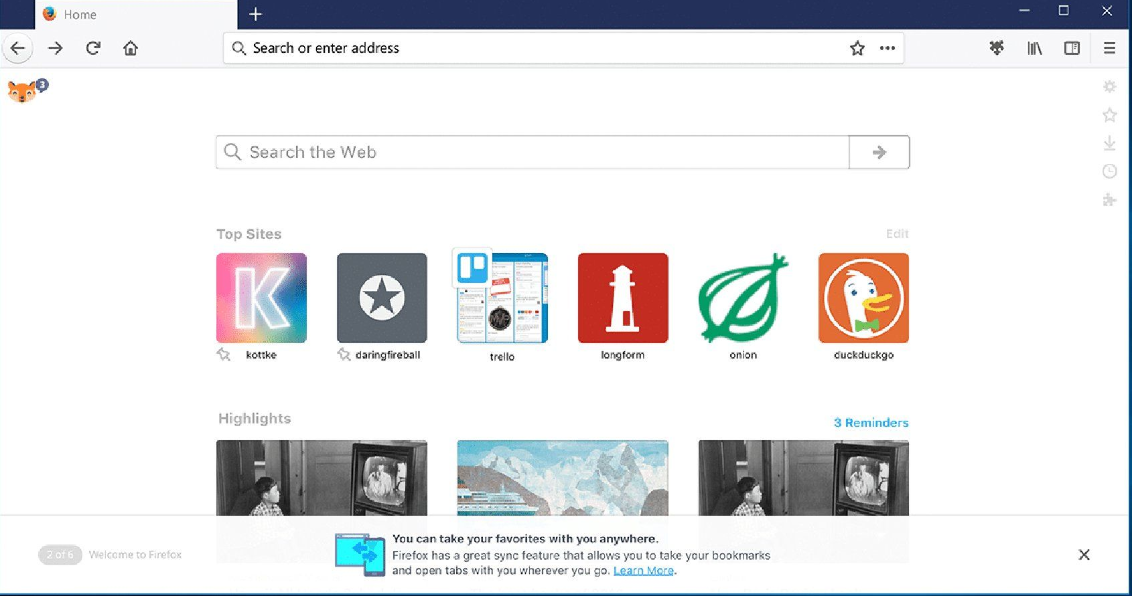
Browsers

Slide 9
Opening a Webpage
The user type the web page address in the browser address bar.
The webpage address is called URL (Unified Resource Locator).
An HTTP request is created, using HTTP (Hypertext Transfer Protocol).
The HTTP request is then sent using TCP/IP protocol.
The HTTP request reached the server.
The server send a response:
The page requested.
Other message, e.g: Error message (404 page is not found)

Slide 10
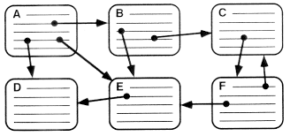
Hypertext
Text with embedded links to text in other documents to allow non sequential (non linear) browsing of textual material.
It is used by the World Wide Web to share documents.

Slide 11

The World Wide Web (WWW)
CERN (Conseil Européen pour la Recherche Nucléaire, or European Organization for Particle Physics) proposed:
A new protocol for the Internet (HTTP)
A system of document access to use it (WWW).
The goal was:
To allow scientists around the world to use the Internet to exchange documents describing their work
*

Slide 12
The World Wide Web (WWW)
The proposed new system was designed to:
Allow a user anywhere on the Internet to search for and retrieve documents (web pages) from databases on any number of different document-serving computers connected to the Internet.
For the form of its documents, the system used hypertext.
Note: From here on, we will refer to the World Wide Web simply as “the Web.” or pages, documents, and resources.

Slide 13

The Web and Documents/Pages
Documents are sometimes just text, usually with embedded links to other documents.
They often also include images, sound recordings, or other kinds of media.
When a document contains non textual information, it is called hypermedia.
Examples of non textual?
Sound/Music.
Images/Animation./Videos.
The Web is a vast collection of documents, some of which are connected by links.
These documents are accessed by Web browsers.

Slide 14
The Hypertext Transfer Protocol (HTTP)
All Web communications transactions use the same protocol:
The Hypertext Transfer Protocol (HTTP)
HTTP consists of two phases:
The request
The response.
Each HTTP communication (request or response) between a browser and a Web server consists of two parts: a header and a body.
The header contains information about the communication.
The body contains the data of the communication if there is any.
Note: for more on HTTP Request, check this link.

Slide 15
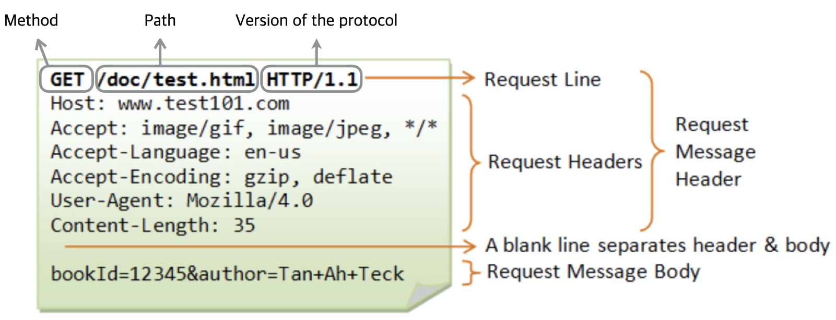
HTTP Request
*

Slide 16
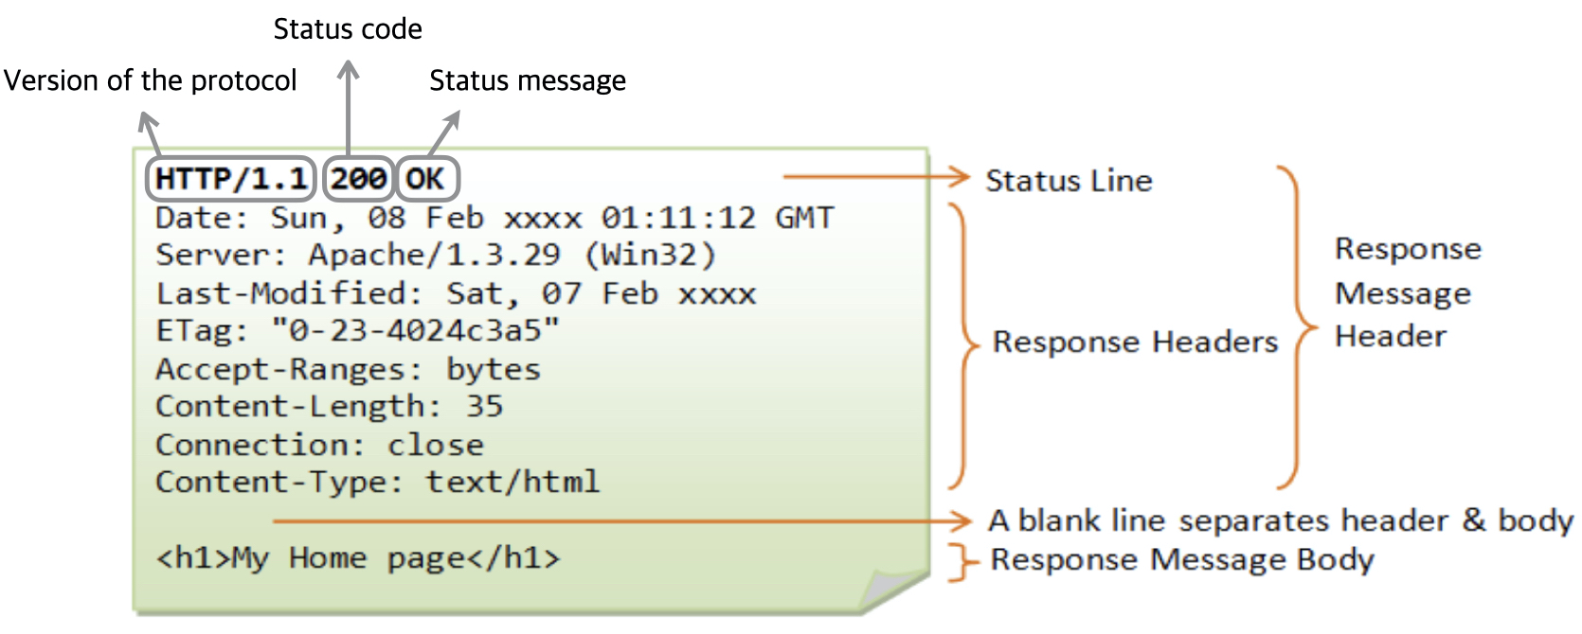
HTTP Response
*

Slide 17
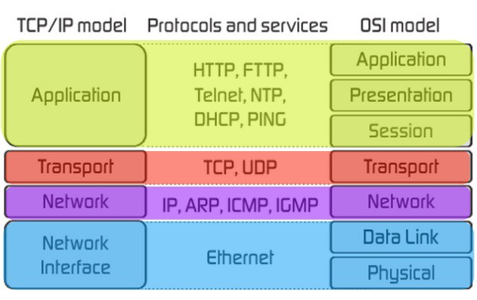
TCP/IP Protocol
Higher level protocols runs on top of TCP/IP.
TCP/IP can be used directly to allow a program on one computer to communicate with a program on another computer via the Internet.
TCP/IP provides the low-level interface that allows most computers (and other devices) connected to the Internet to appear exactly the same.
*

Slide 18
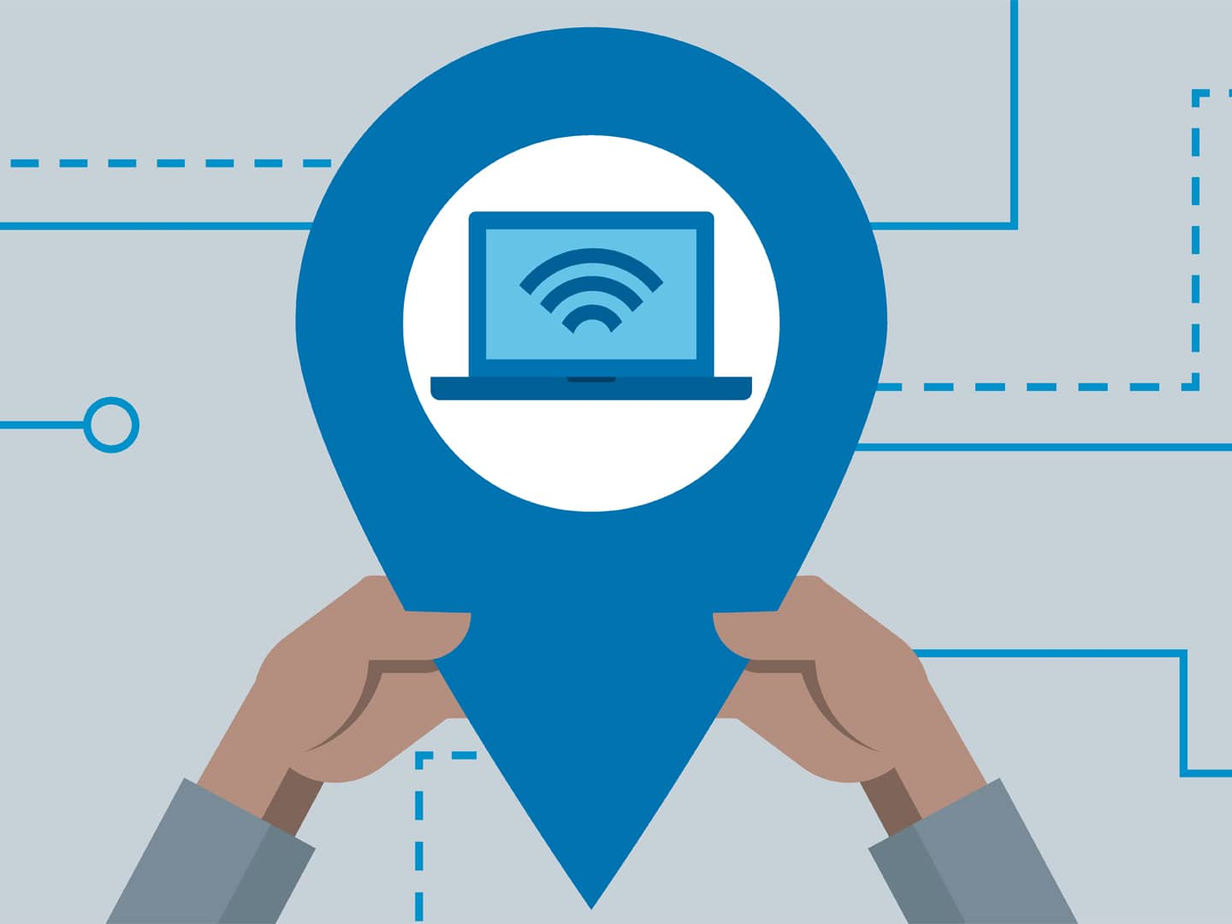
IP
Yes, we need a way to identify the device we want to connect to in order to reach them.
All devices connected to the Internet must be uniquely identifiable.
Is this correct or not?! Why?!
For people, Internet nodes are identified by names. (Domain Name).
For computers, they are identified by numeric addresses (IP).

Slide 19
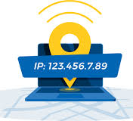
IP
The Internet Protocol (IP) address of a machine connected to the Internet is a unique 32-bit number.
IP addresses usually are written (and thought of) as four 8-bit numbers (IPv4), separated by periods.
Google.com ip address is: 172.217.19.142
The four parts are separately used by Internet-routing computers to decide where a message must go next to get to its destination.
New standard, IPv6, has 128 bits

Slide 20
Domain Name
Domain name are textual names of machines on the internet.
E.g: www.google.com is the name of the server where google search engine is located.
Why we need domain names? Why don’t use IPs?
Because IP addresses are the addresses used internally by the Internet, the Domain name are inserted into a web browser as URL.
Like IP addresses, domain names must be unique.
Because people have difficulty dealing with and remembering numbers.

Slide 21
Domain Name
Domain name, of the destination, must be converted to an IP address before the message can be transmitted over the Internet to the destination.
These conversions are done by software systems called name servers, which implement the Domain Name System (DNS).

Slide 22
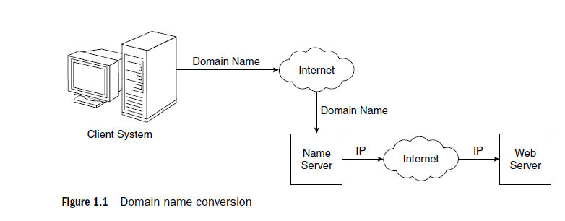
Domain name Conversion

Slide 23
Domain Name System (DNS)
Name servers serve a collection of machines on the Internet and are operated by organizations that are responsible for the part of the Internet to which those machines are connected.
All document requests from browsers are routed to the nearest name server.
If the name server can convert the domain name to an IP address, it does so.
If it cannot, the name server sends domain name to another name server for conversion.

Slide 24
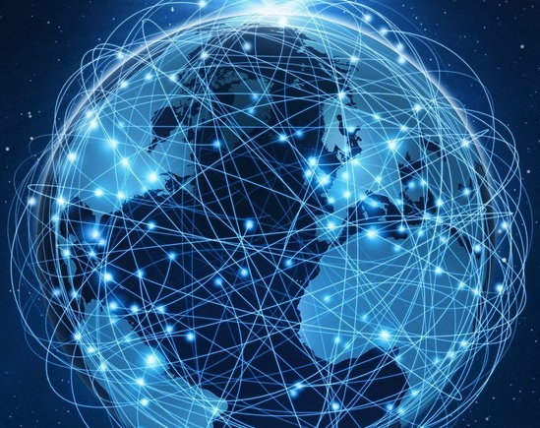
What is the internet?!
The Internet is a huge collection of computers connected in a communications network.
Network of networks.
These computers are of every imaginable size, configuration, and manufacturer.
Apple, Windows, Asus etc.
In fact, some of the devices connected to the Internet are not computers at all.
PlayStation, phones, printers, coffee machines etc.

Slide 25
Internet
A protocol is a standard set of rules that allow electronic devices to communicate with each other.
All of these diverse devices to communicate with each other is a single, low-level protocol:
the Transmission Control Protocol/Internet Protocol (TCP/IP).
What is a protocol?
A protocol is a standard set of rules that allow electronic devices to communicate with each other.
There are other protocols used when communicating over the internet.
User Datagram Protocol/Internet Protocol (UDP/IP) is an alternative that is used in some situations.

Slide 26
Different Protocols
Collection of different protocols that run on top of TCP/IP had been developed to support a variety of Internet uses.
Among these protocols, the most common were:
Telnet, which was developed to allow a user on one computer on the Internet to log onto and use another computer on the Internet;
File Transfer Protocol (ftp), which was developed to transfer files among computers on the Internet;
Usenet, which was developed to serve as an electronic bulletin board;
Mailto, which was developed to allow messages to be sent from the user of one computer on the Internet to other users of other computers on the Internet.

Slide 27
Internet Vs WWW (World wide web, the web)
The Internet and the Web are not the same thing.
The Internet is a collection of computers and other devices connected in networks.
The Web is a collection of software and protocols that has been installed on most, if not all, of the computers on the Internet.
Some of these computers run Web servers, which provide documents.
Most run Web clients, or browsers, which request documents from servers and display them to users.
The Internet was quite useful before the Web was developed, and it is still useful without it.
However, most users of the Internet now use it through the Web.

Slide 28
Web Browsers: Client - Server
When two computers communicate over some network, in many cases one acts as a client and the other as a server.
The client initiates the communication, which is often a request for information stored on the server.
The server then sends that information back to the client.
The Web, as well as many other systems, operates in this client-server configuration.
Documents provided by servers on the Web are requested by browsers, which are programs running on client machines.

Slide 29
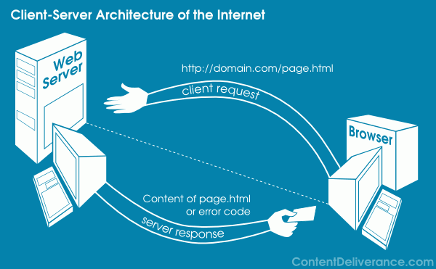
Web Browsers: Client - Server

Slide 30
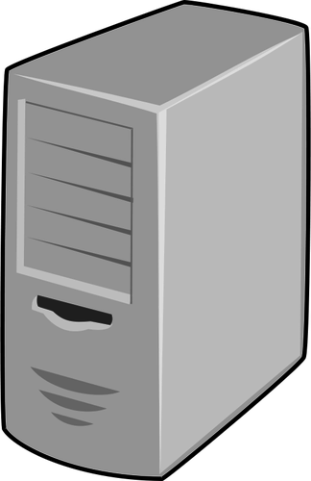
Web Servers
Web servers are programs that provide documents to requesting browsers.
Servers are slave programs:
They act only when requests are made to them by browsers running on other computers on the Internet.
Web browsers (client) initiate network communications with servers by sending them URLs.

Slide 31
Web Servers
A URL can specify one of two different things:
The address of a data file stored on the server that is to be sent to the client.
E.g HTML pages.
Program stored on the server that the client wants executed, with the output of the program returned to the client
E.g Database Query.
All the communications between a Web client and a Web server use the standard Web protocol, Hypertext Transfer Protocol (HTTP).

Slide 32
Uniform Resource Locators (URL)
Uniform (or universal) resource locators (URLs) are used to identify documents (resources) on the Internet.
All URLs have the same general format:
scheme://object-address
The scheme is often a communications protocol, E.g: http://
The object address consist of:
//domain-name/path-to-document.
E.g: //gumboco.com/storefront.html
The full url is:
http://www.gumboco.com/storefront.html

Slide 33
Uniform Resource Locators (URL)
The path to the file may consist of directory and file names.
http://www.gumboco.com/departments/index.html
If the specified document is a directory rather than a single document, the directory’s name is followed immediately by a slash, as in the following:
http://www.gumboco.com/departments/
The server then searches at the top level of the directory in which servable documents are normally stored for something it recognizes as a home page.
By convention, this page is often a file named index.html.
The home page usually includes links that allow the user to find the other related servable files on the server.

Slide 34
Uniform Resource Locators (URL)
URL's are commonly referred to as Web addresses
the different parts of the Web address provide information for locating the page.
We have seen some parts, what about the other parts?
http://www.gumboco.com/storefront.html
What about: www and com?
For information about www click on the link.
com is what we call Top Level Domain names.

Slide 35
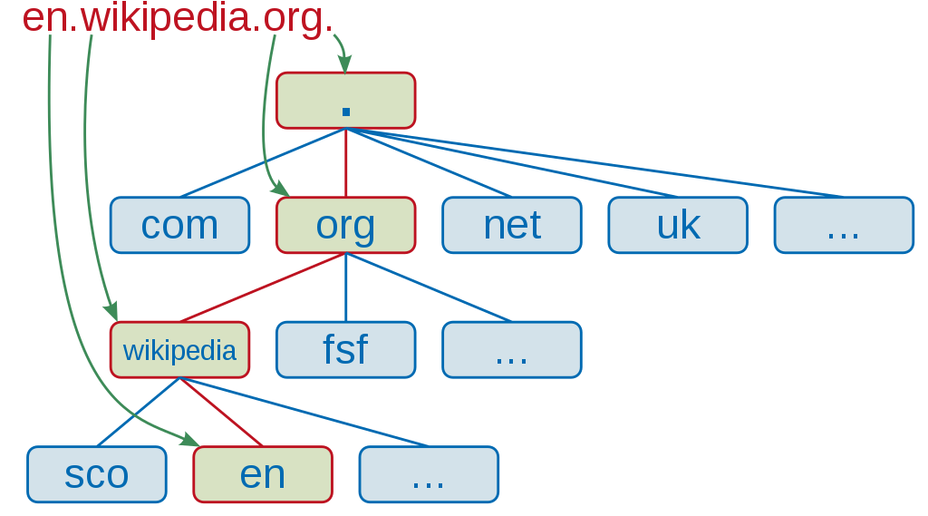
Uniform Resource Locators (URL)
A top-level domain (TLD) is one of the domains at the highest level in the hierarchical Domain Name System of the Internet.
Top-Level Domain Name.
E.g: com, net, org, edu, sa … etc.
A top-level domain (TLD) identifies the right-most part of the domain name.

Slide 36
Top-Level Domain Name
Country:
Two character codes originally intended to indicate the geographical location (country) of the web site, Eg:
sa, us, uk, jp.. etc
Organization:
edu is for educational institutions,
com for a company,
gov is used for the government,
org is used for many other kinds of organizations
Sometimes we can have more than on TLD, e.g:
www.yu.edu.sa

Slide 37
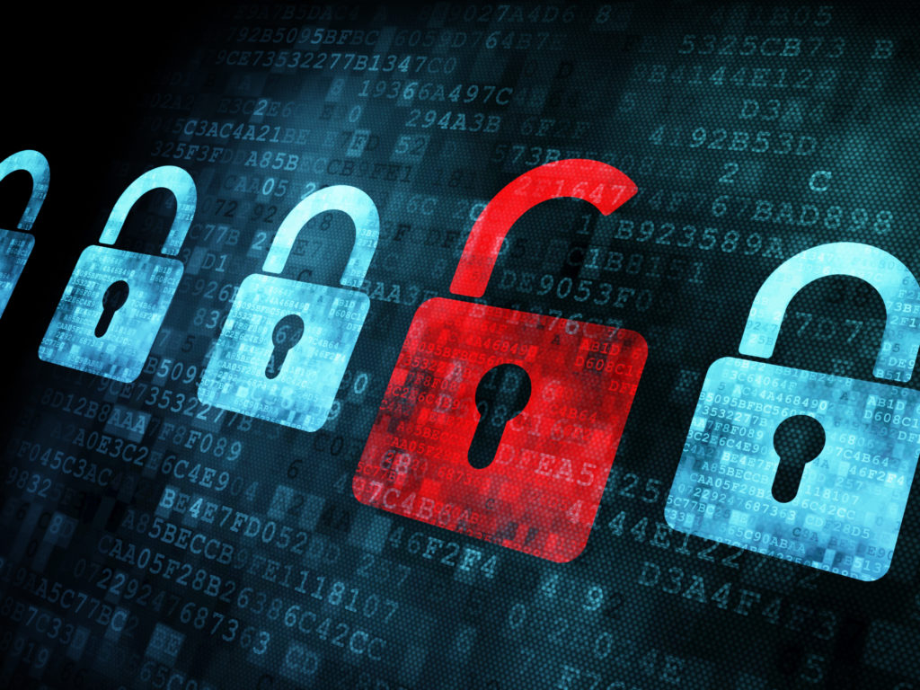
Security
Does web developers face security issues?
What do you think are the security issues web developers face?

Slide 38
Security
Web development has many security issues.
One main security issue is getting data from/to the web server/client without being read by, modified or destroyed by anyone.
This of the following examples:
You are entering your credit card number to buy something online, you don’t want your credit card number to be intercepted and stolen by anyone, right?!
You are doing money transfer, the amount you are transferring is 1000 sar. You don’t want anyone to intercept and modified the amount to 1000000 sar, right?!
You are sending a request to check your result on edugate, however, your request is not reaching the server. The request data is being destroyed on the way. It is very frustrating right?!

Slide 39

Security Issues
Privacy
It must not be possible for the data to be stolen on its way to destination.
Hello

Slide 40
Security Issues
Integrity
It must not be possible for the data to be modified on its way to the destination.
Hello
eLLo

Slide 41

Security Issues
Authentication
It must be possible for both the sender and the receiver to be certain of each other’s identity.

Slide 42
Security Issues
Nonrepudiation
It must be possible to prove legally that the message was actually sent and received.
Assurance that:
The sender of information is provided with proof of delivery.
The recipient is provided with proof of the sender’s identity, so neither can later deny having processed the information.
In other words, neither can later deny having processed the data.
For more about Nonrepudiation check this link.

Slide 43
Counter Measures
The basic tool to support privacy and integrity is encryption.
Data to be transmitted is converted into a different form, or encrypted, such that someone (or some computer) who is not supposed to access the data cannot decrypt it.
We can use public and private keys for encryption.
H3hs#jeh301

Slide 44
Counter Measures
For Authentication, there are different ways to identify the send and receiver.
The client may use a password or fingerprint etc.
The server may use certificates.
There is the use of SSH connection via the use of public and private keys.

Slide 45
Counter Measures
For Nonrepudiation, It is a combination of:
Authentication.
Logging.
a log file is a file that records either events that occur in an operating system or other software runs, or messages between different users of a communication software.
Auditing.
The examination and evaluation of an organization's information technology infrastructure, applications, data use and management, policies, procedures and operational processes against recognized standards or established policies.
Digital Signature.
A mathematical technique used to validate the authenticity and integrity of a message, software or digital document.

Slide 46




Counter Measures
For Nonrepudiation, Digital Signature.
A
B
A
B
Sender A, will use the receiver B's public key to encrypt a message.
Receiver B uses their own private key to decrypt the message from A
B uses A’s public key to encrypt the reply.
A uses A’s private key to decrypting.
Public Key
Private Key

Slide 47
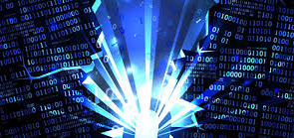
Data Destruction
The sheer number of such attacks has also grown rapidly.
There is now a continuous stream of new and increasingly devious:
Denial-of service (DoS) attacks, Viruses and Worms
being discovered, which have caused billions of dollars of damage, primarily to businesses that use the Web heavily.

Slide 48
Denial-of service (DoS) attacks
DoS attacks can be created simply by flooding a Web server with requests,overwhelming its ability to operate effectively.
Most DoS attacks are conducted with the use of networks of virally infected “zombie” computers,
The owners of the infected computers are unaware of their sinister use.
So, DoS and viruses are often related.
There is even a server type of DoS, A Distributed Dos (DDoS).
A DoS attack is a denial of service attack where a computer (or computers) is used to flood a server with TCP and UDP packets.
A DDoS attack is where multiple systems target a single system with a DoS attack.
The targeted network is then bombarded with packets from multiple locations.

Slide 49
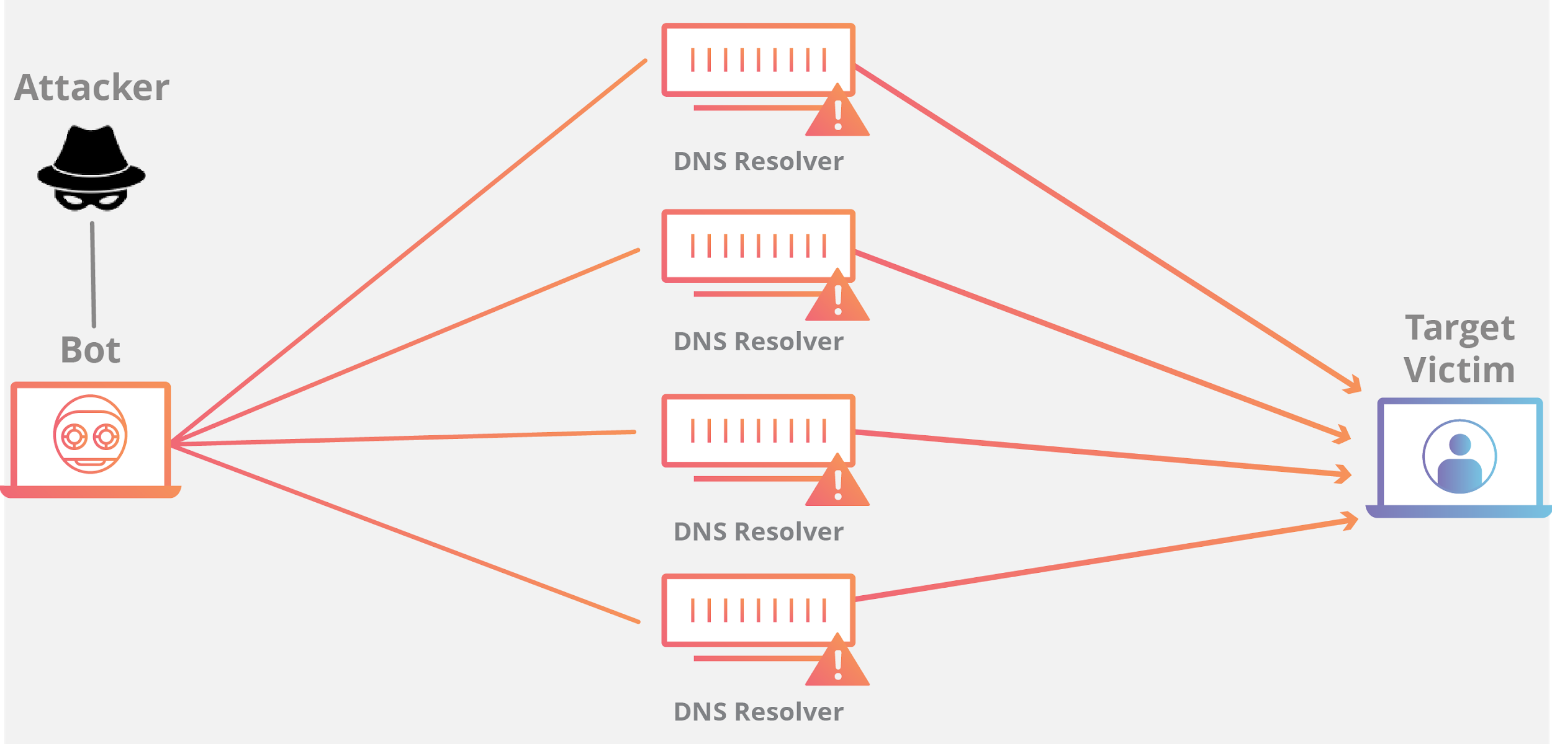
DoS

Slide 50
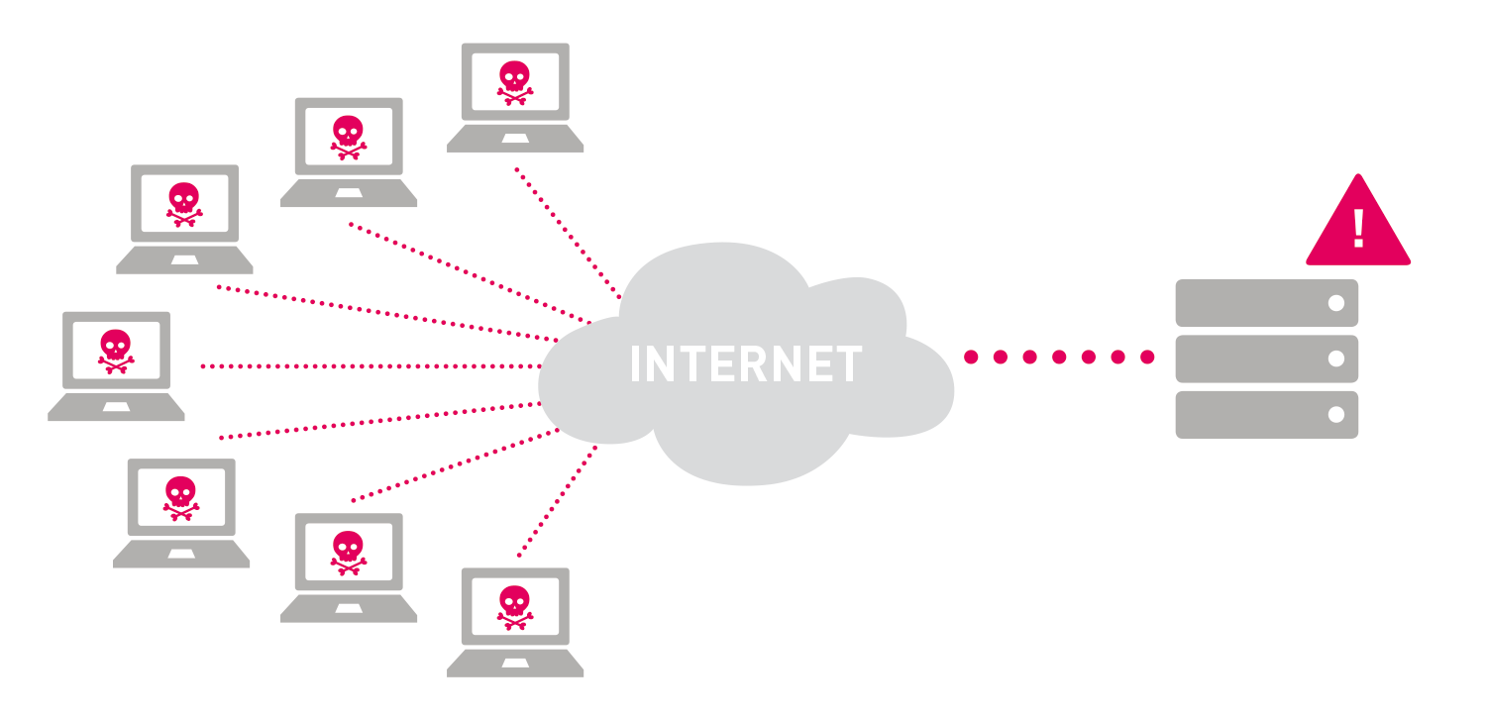
DDoS

Slide 51
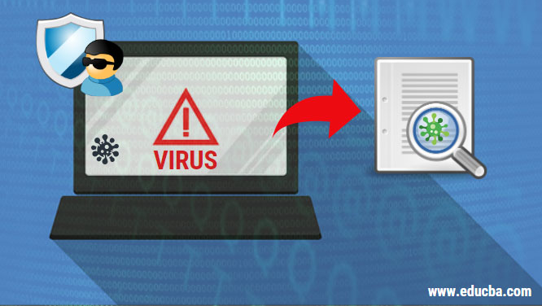
Viruses
Viruses are harmful programs that often arrive in a system in attachments to e-mail messages or attached to free downloaded programs.
When executed, they replicate and can overwrite memory and attached memory devices, destroying programs and data alike.
Two viruses that were extensively destructive appeared:
The ILOVEYOU virus (2000).
The CodeRed virus (2001).

Slide 52
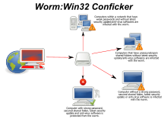
Worms
Worms damage memory, like viruses, but spread on their own, rather than being attached to other files.
Perhaps the most famous worm so far has been the Blaster worm, spawned in 2003.

Slide 53
Conclusion
DoS, virus, and worm attacks are created by malicious people referred to as hackers.
The incentive for these people apparently is simply the feeling of pride and accomplishment they derive from being able to cause huge amounts of damage by outwitting the designers of Web software systems.
Protection against viruses and worms is provided by antivirus software.
E.g Kaspersky.
Antivirus software must be updated frequently so that it can detect and protect against the continuous stream of new viruses and worms

Slide 54
Resources
Programming the World Wide Web - Pearson. Chapter 1.
W3 School.

